Slide 1
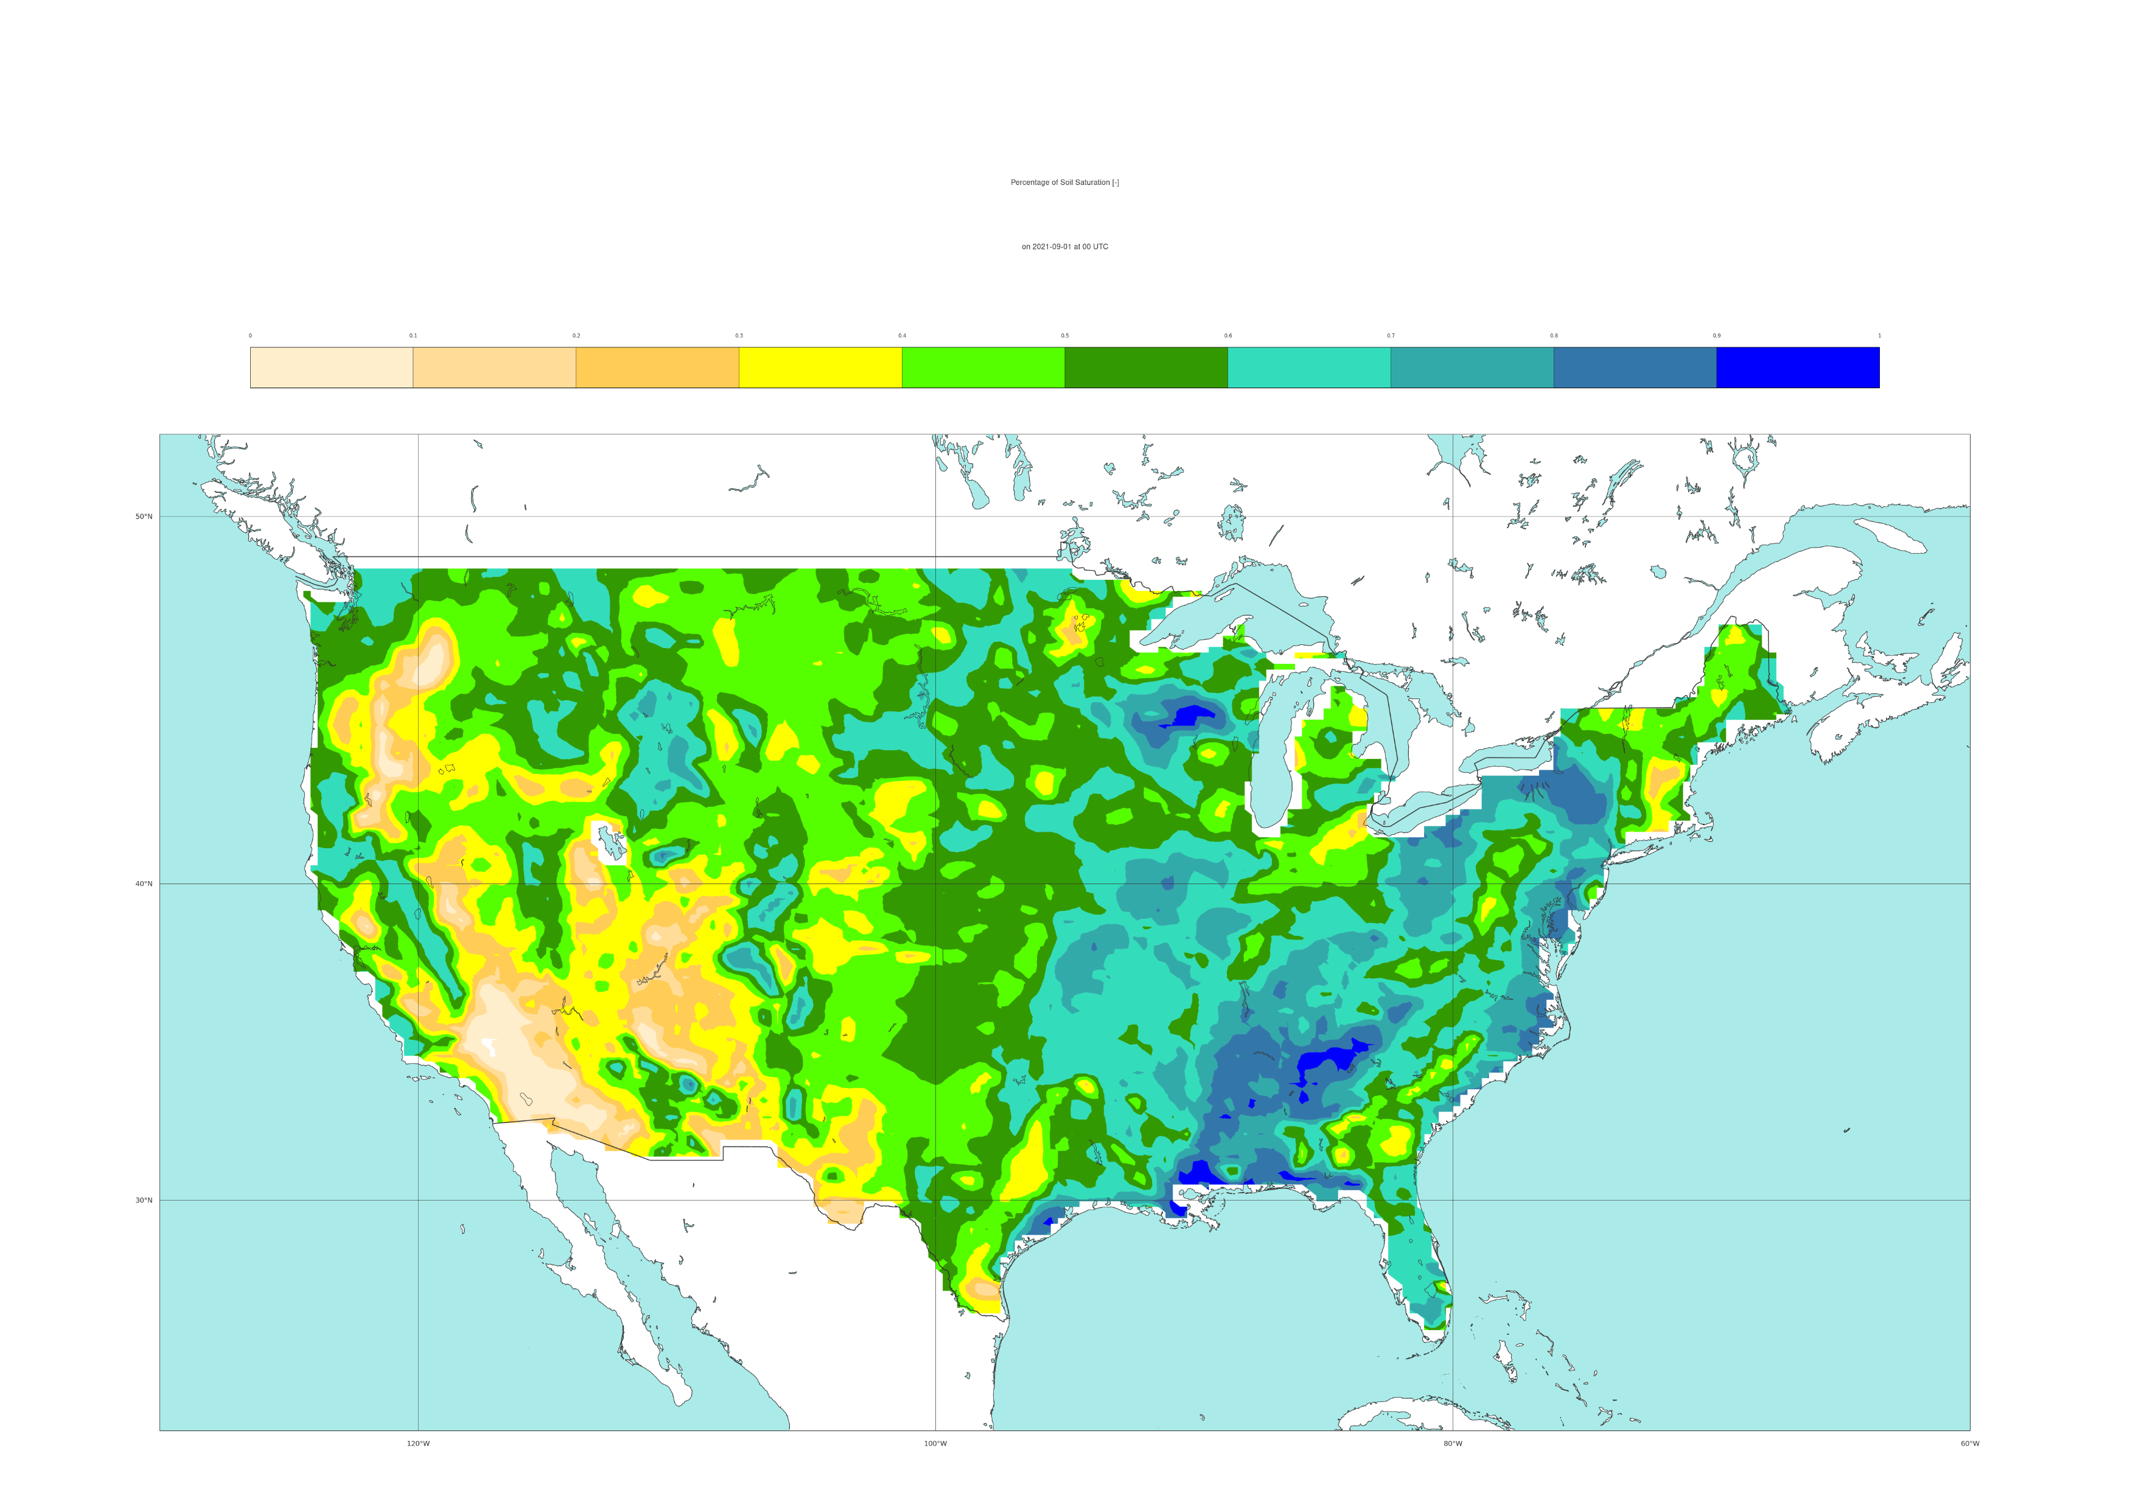

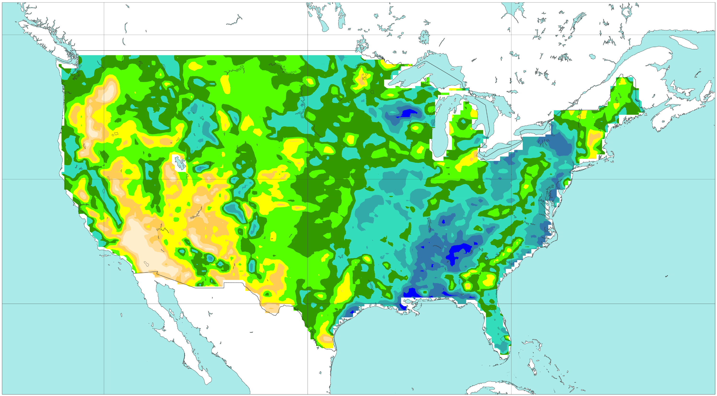




ERA5 variables used in the data-driven model
Example of percentage of soil saturation (VT: 2021-09-01 at 00 UTC)
[%]
0
10
20
30
40
50
60
70
80
90
100
a) short-range forecast (reanalysis)
b) long-range forecast (t+0,t+24)
50 °N
40 °N
30 °N
c) long-range forecast (t+24,t+48)
d) long-range forecast (t+48,t+72)
50 °N
40 °N
30 °N
e) long-range forecast (t+72,t+96)
f) long-range forecast (t+96,t+120)
50 °N
40 °N
30 °N
120 °W
100 °W
80 °W
120 °W
100 °W
80 °W

